Slide 1
AI for Kids
UK Robotics Week 2024

Slide 2
This Story is about my story is about two superhero girls sisters Zena 8 years old Hannah 5 years old they are using generative AI in everyday to become better if use it efficiently and ethically
This story is created by:
Xeinah
Hanah
Manal

Slide 3
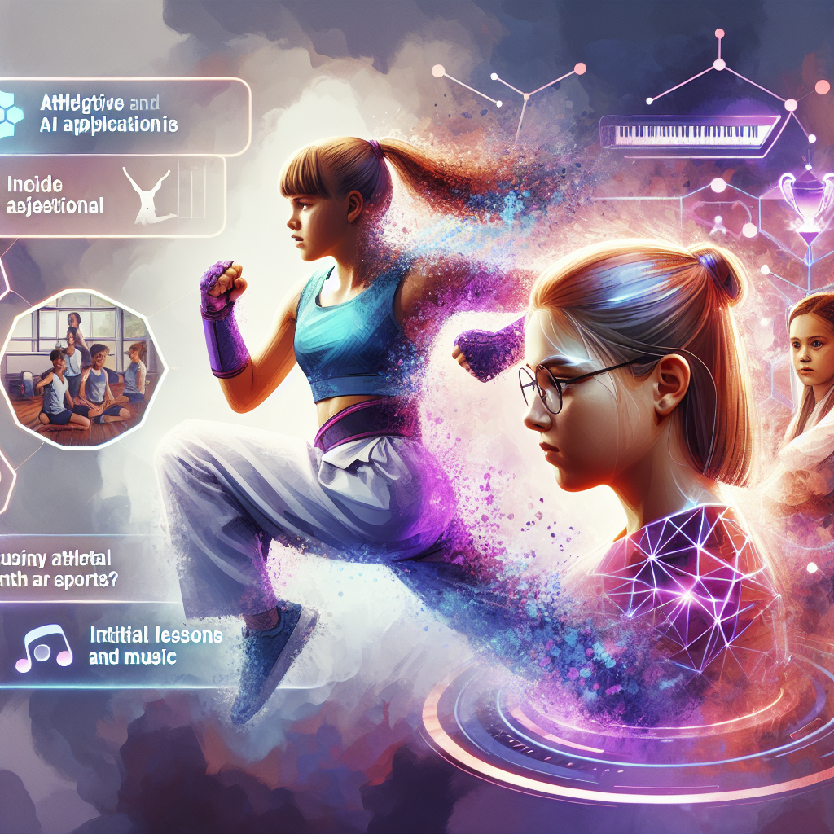
1. The superhero starts his day using generative AI to plan healthy breakfast, school activities, and engage with others. 2. The superhero also uses generative AI to study history and ancient civilizations effectively. 3. As the superhero progresses to university, he delves into comparative history studies. 4. Upon graduating, the superhero considers a good historical question for a Ph.D. in archaeology. 5. In another story, a primary school girl is interested in using generative AI to learn geography. 6. The superhero in that story effectively uses generative AI for various tasks, including school projects and leisure advice. 7. Transitioning
to university, the superhero focuses on geography studies with the help of generative AI. 8. The superhero further pursues a Ph.D. in geography with the support of generative AI suggestions. 9. Another story introduces two young sisters, Zana and Hannah, who are yet to explore generative AI. 10. Zana utilizes generative AI to improve her karate skills while exploring other sports suitable for Hannah's age. 11. The family's diverse professional backgrounds prompt a consideration of paths into the generative AI field. 12. For Hannah's development in both music and sports, generative AI could play a role in her learning journey.
An energetic and strong depiction of a young girl named Xena, demonstrating her karate moves. She is using a virtual assistant that uses generative AI technology to guide her through new techniques and strategies. Nearby, another young girl named Hannah is seen showing a lack of interest in sports. The objective here is to inspire her towards athletic and musical pursuits. Can there be a scene involving intelligent AI applications providing her initial lessons in both sports and music?

Slide 4
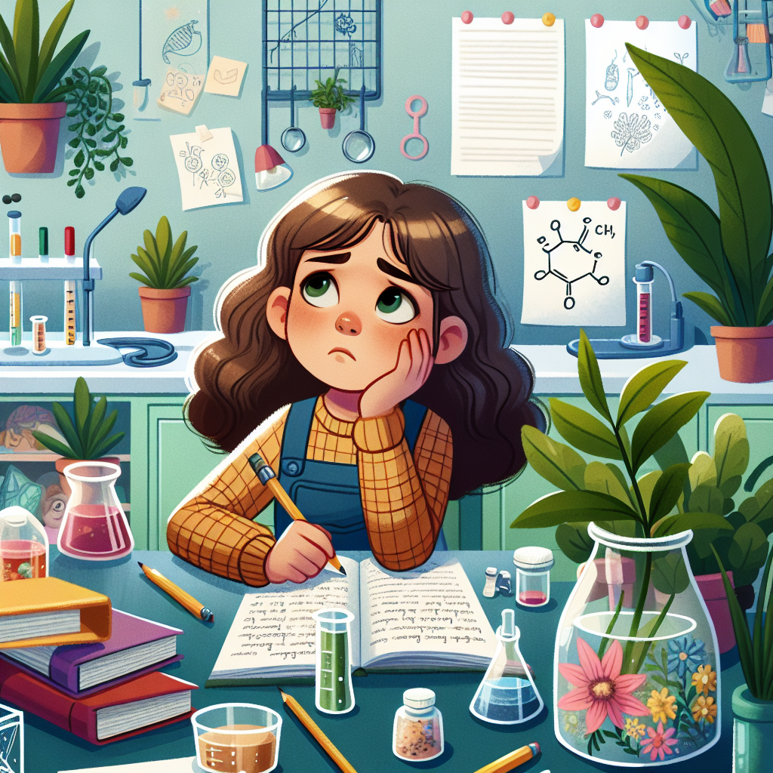
children_story_book_2_1.pptx: The superhero starts the day with generative AI for a healthy breakfast, plans school activities, engages with teachers, and advises family on leisure. children_story_book_3.pptx: The superhero uses generative AI for breakfast, school planning, studying, and family advice. children_story_book_4.pptx: The superhero uses generative AI for breakfast, school planning, studying,
homework, and family advice. children_story_book_7.pptx: The superhero uses generative AI for geography studies in school, university, and PhD research. children_story_book_10.pptx: Introducing generative AI to Zana and Hannah for sports, music, and career decisions. children_story_book_12.pptx: Xena uses generative AI for karate, while Hannah explores sports and music with potential AI assistance.
Imagine an illustrated children's story book featuring an 8-year-old girl who is caught in a dilemma. She is trying to decide whether she wants to follow the path of her grandmother, a prominent ecologist, or whether she wants to pursue a career as a medical doctor or an engineer. She sits in her room, surrounded by textbooks and notes, her eyes reflecting her inner struggle. The room is a mix of lush green plants, a nod to her grandmother's profession, medical equipment and engineering tools. Portray this scene in a colorful, friendly, and engaging style, suitable for a children's book.

Slide 5
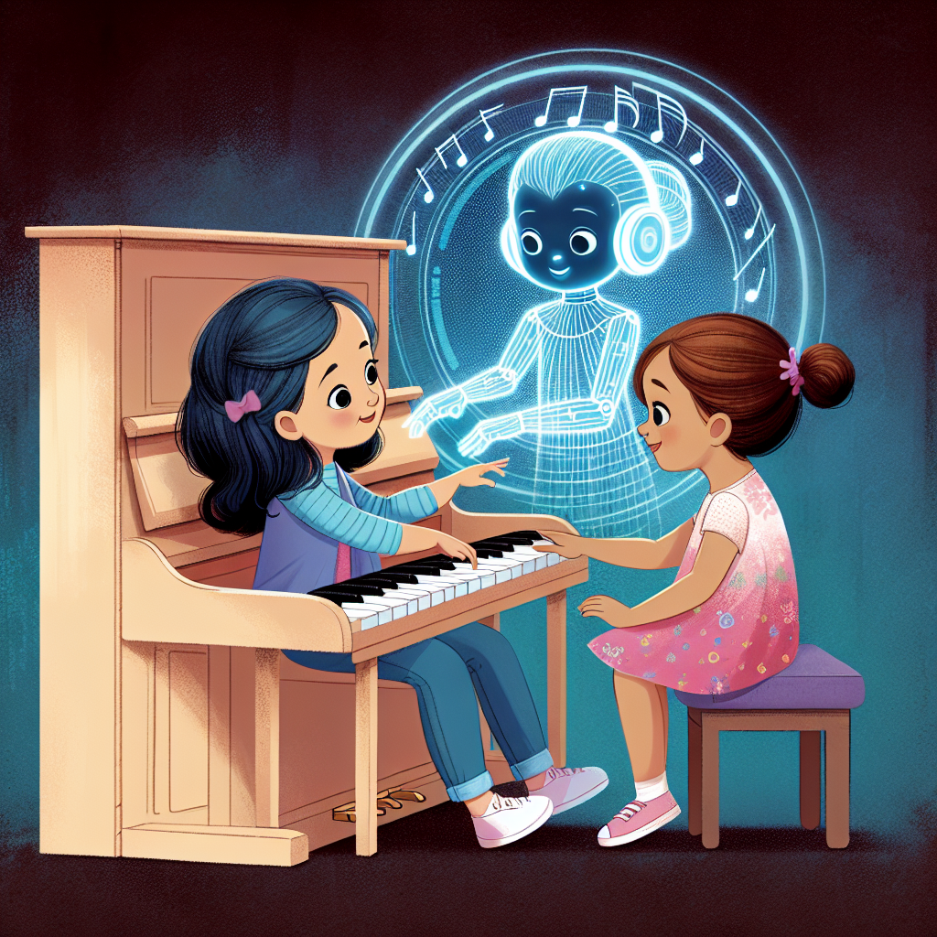
Children's Story Book 2.1: The superhero begins their day by using generative AI to help with tasks from planning breakfast to engaging with teachers and studying. They also assist their family in planning leisure activities. Children's Story Book 3: The superhero continues to rely on generative AI for tasks like planning breakfast, engaging at school, and advising family on leisure. They begin showing interest in history and using AI for learning. Children's Story Book 4: The superhero utilizes generative AI for various tasks, including studying history, engaging with AI in solving homework, and advising family. As they progress through education, they explore more topics, such as archaeology and monuments, with AI's help. Children's Story
Book 7: A primary school kid superhero delves into geography using generative AI for learning and homework. They progress to university, tackling more advanced geography topics and even pursuing a PhD with AI support. Children's Story Book 10: Sisters Zana and Hannah embark on their superhero journeys. Zana uses generative AI for learning karate moves, while the focus turns to introducing sports and music to Hannah, exploring how AI can assist their development. Children's Story Book 12: The sisters continue their adventures, with Zana using AI for karate and Hannah starting to explore sports and music. Important decisions loom, such as Zayna's career path and Hannah's learning journey with the help of generative AI.
An illustration for a children's story book depicting two girls, Hannah and Zayna, around 5 years old. They are both eager to learn new things and are sitting by an open piano, tentatively touching the keys. An ethereal AI hologram is illustrating the keys to press on the piano, aiding them in their learning journey with patient guidance.

